Slide 1
Review – 1
University Academic Management System
Sk.Mustafa Raza Ali Nawaz-25B11AIB13
A.Santhosh – 25B11AI033
A.Durga Prasad – 25B11AI034
K.Vikas – 25B11AI612
→MENTOR :- GL.NARASAMBA

Slide 2
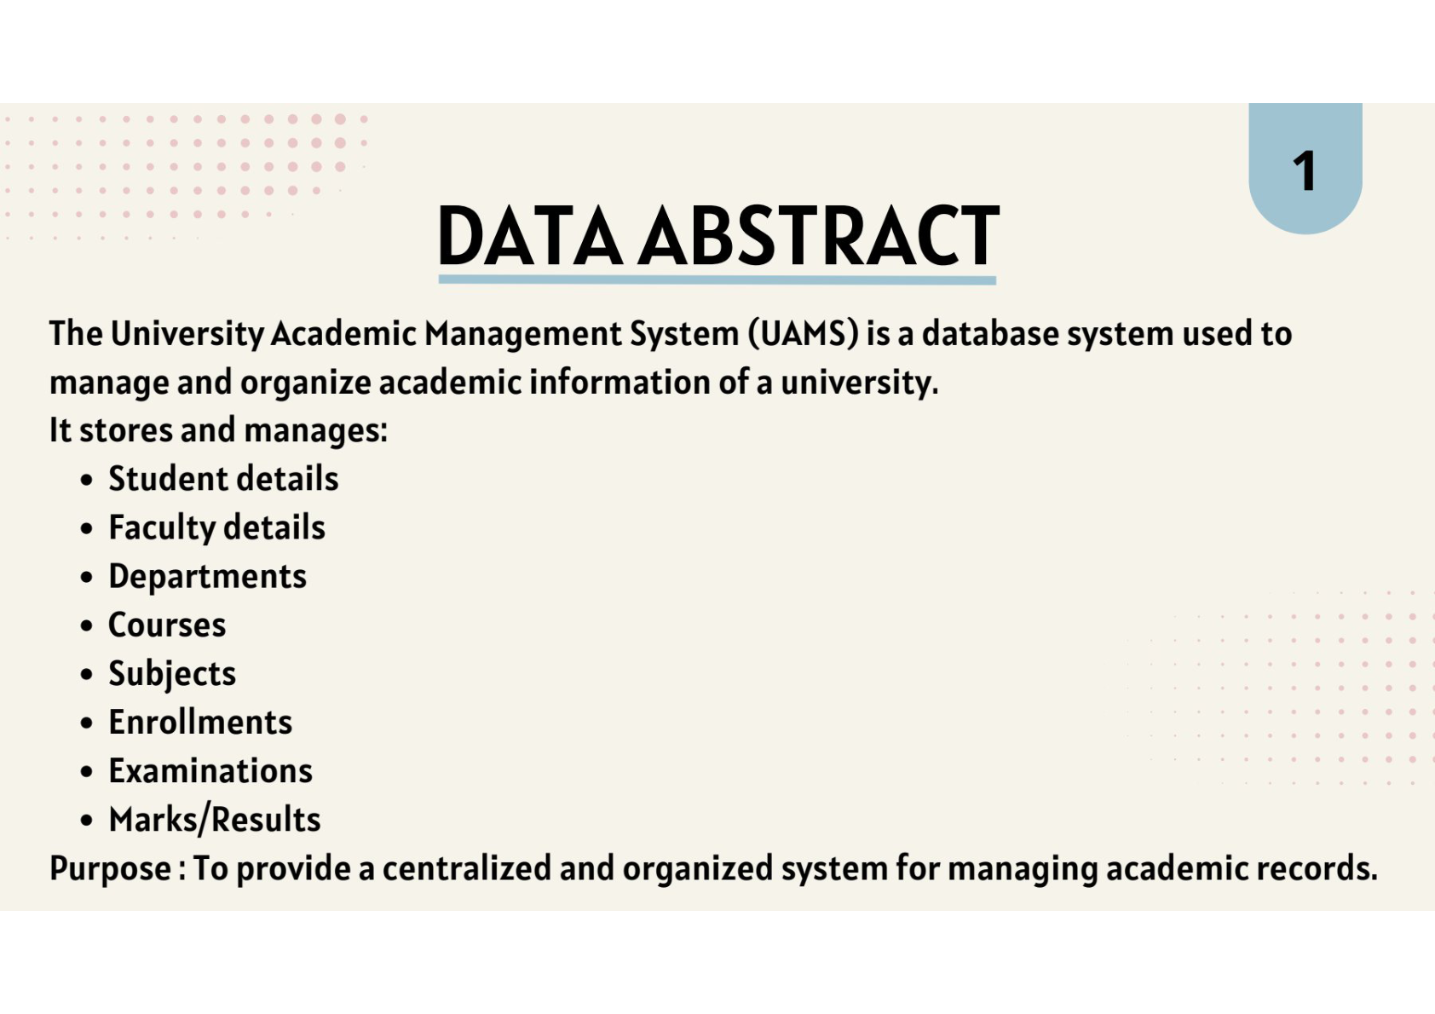

Slide 3
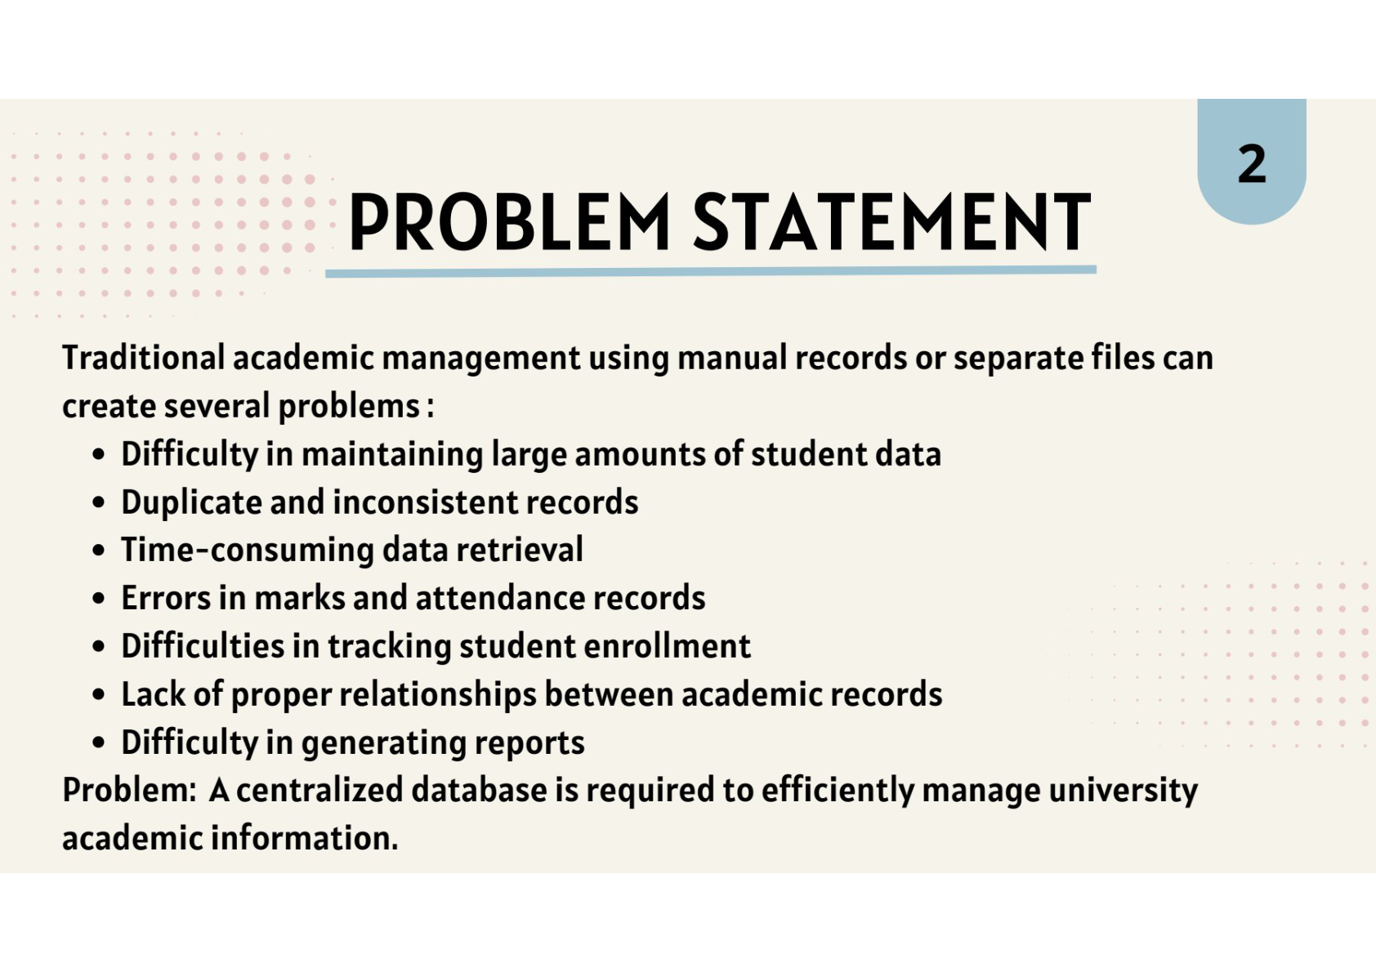

Slide 4
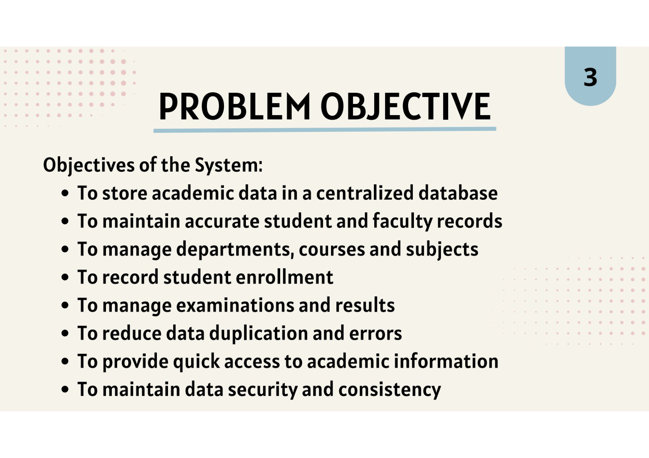

Slide 5
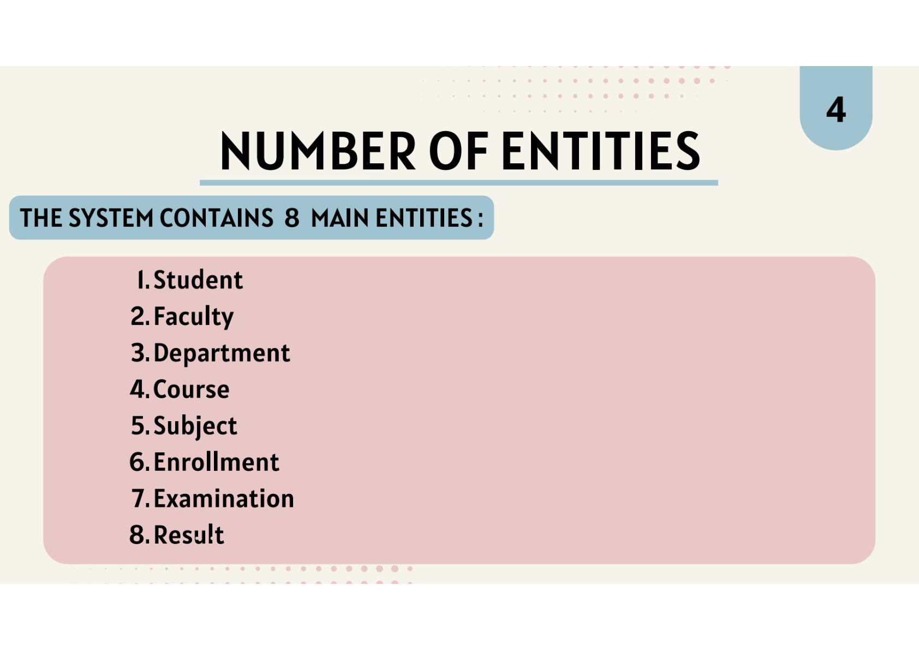

Slide 6
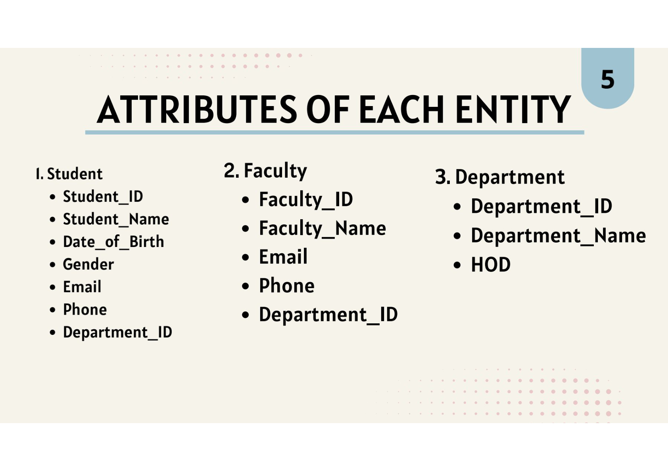

Slide 7
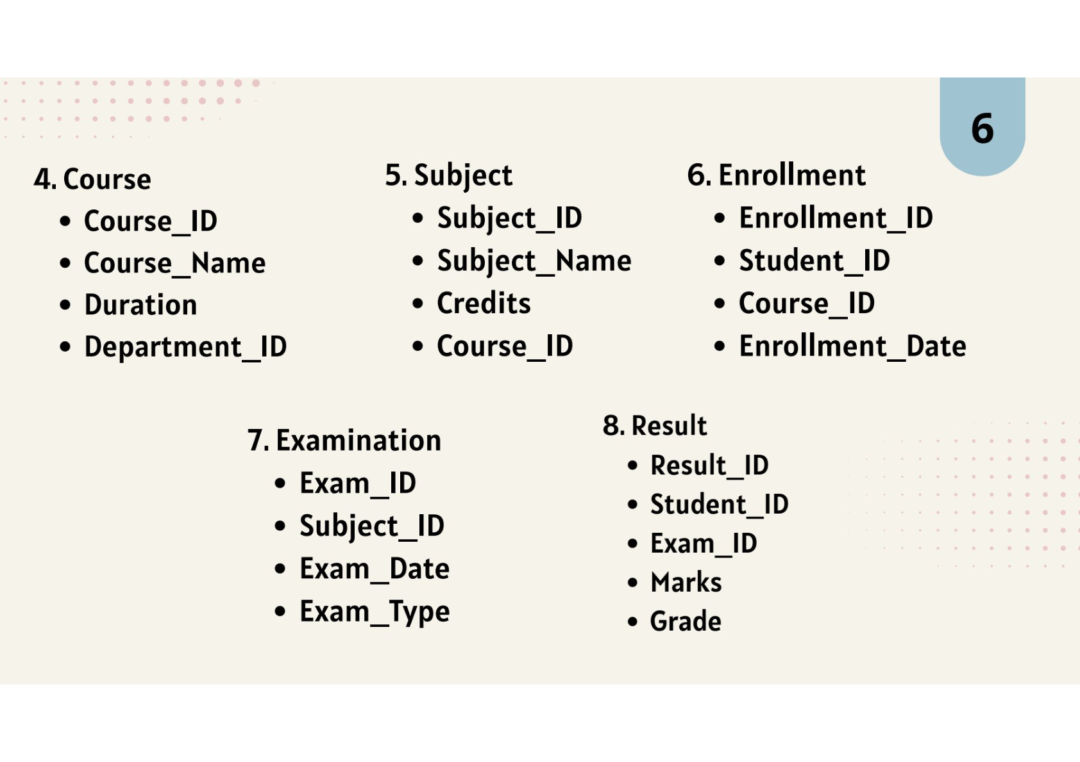

Slide 8
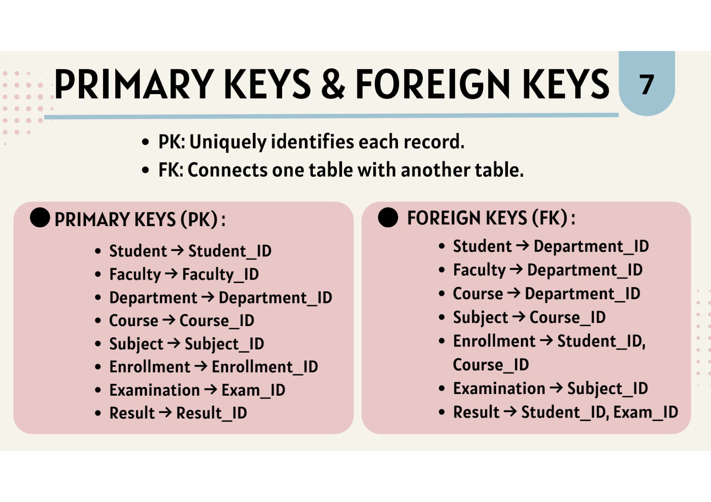

Slide 9
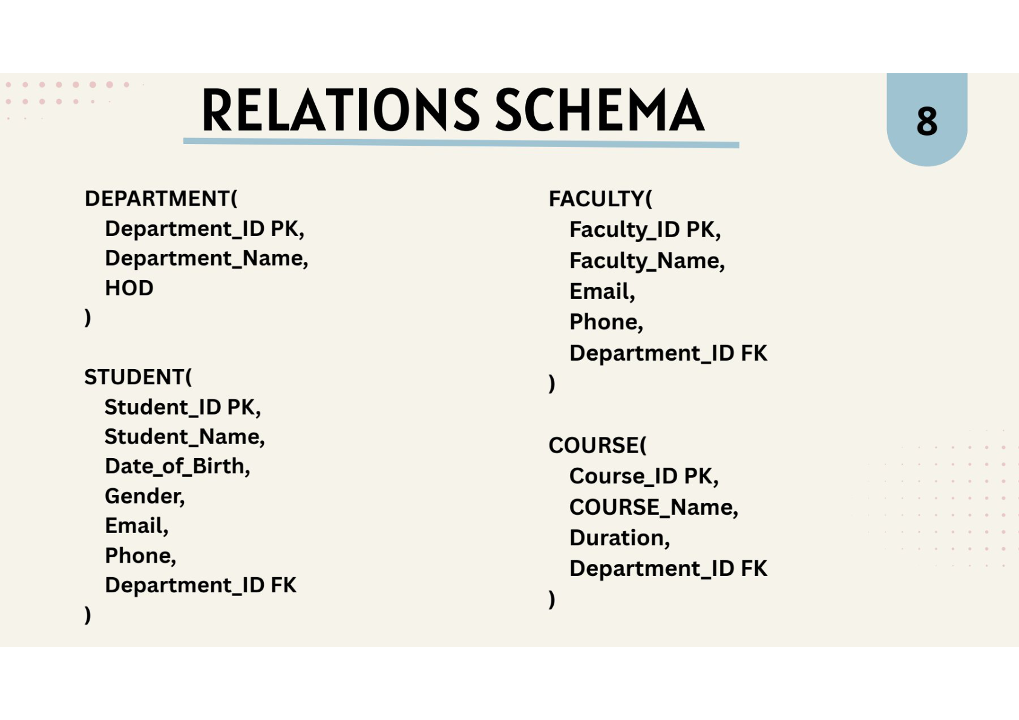

Slide 10
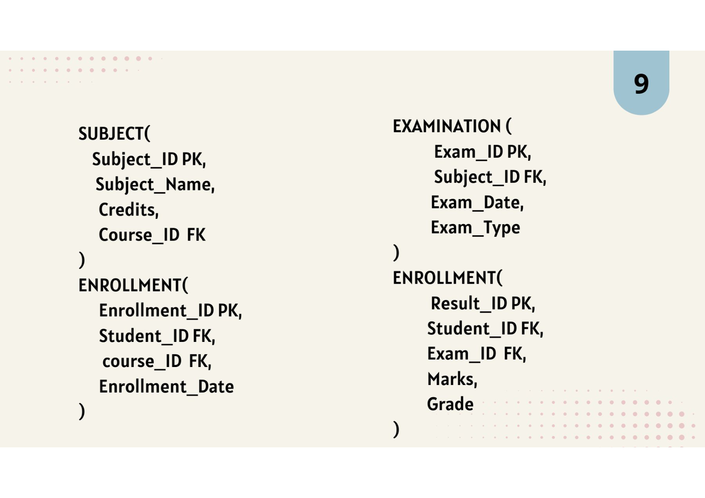

Slide 11
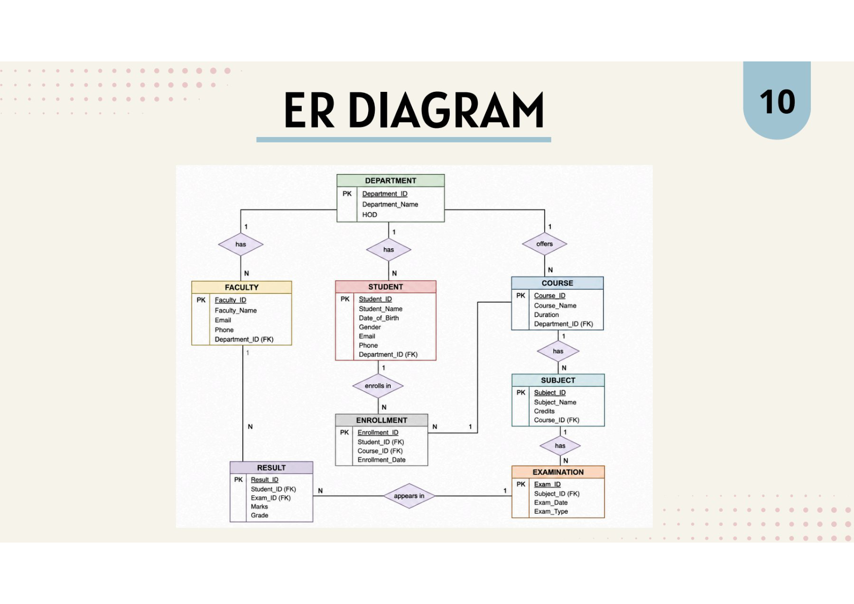

Slide 12
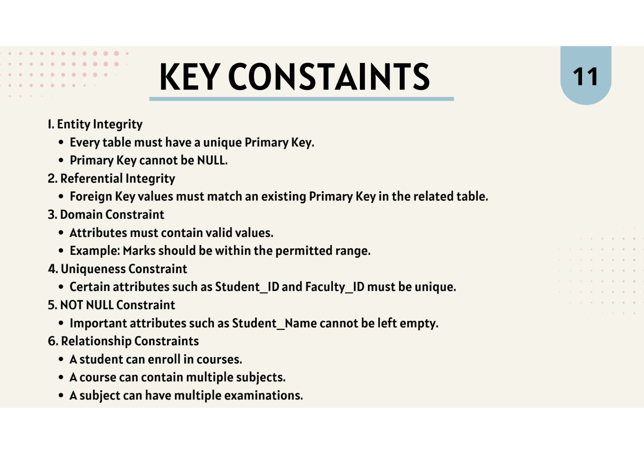

Slide 13
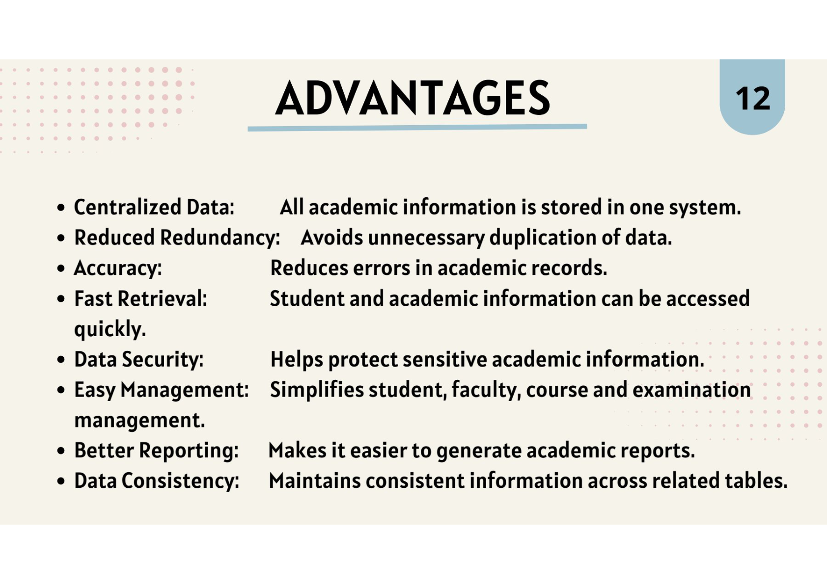

Slide 14
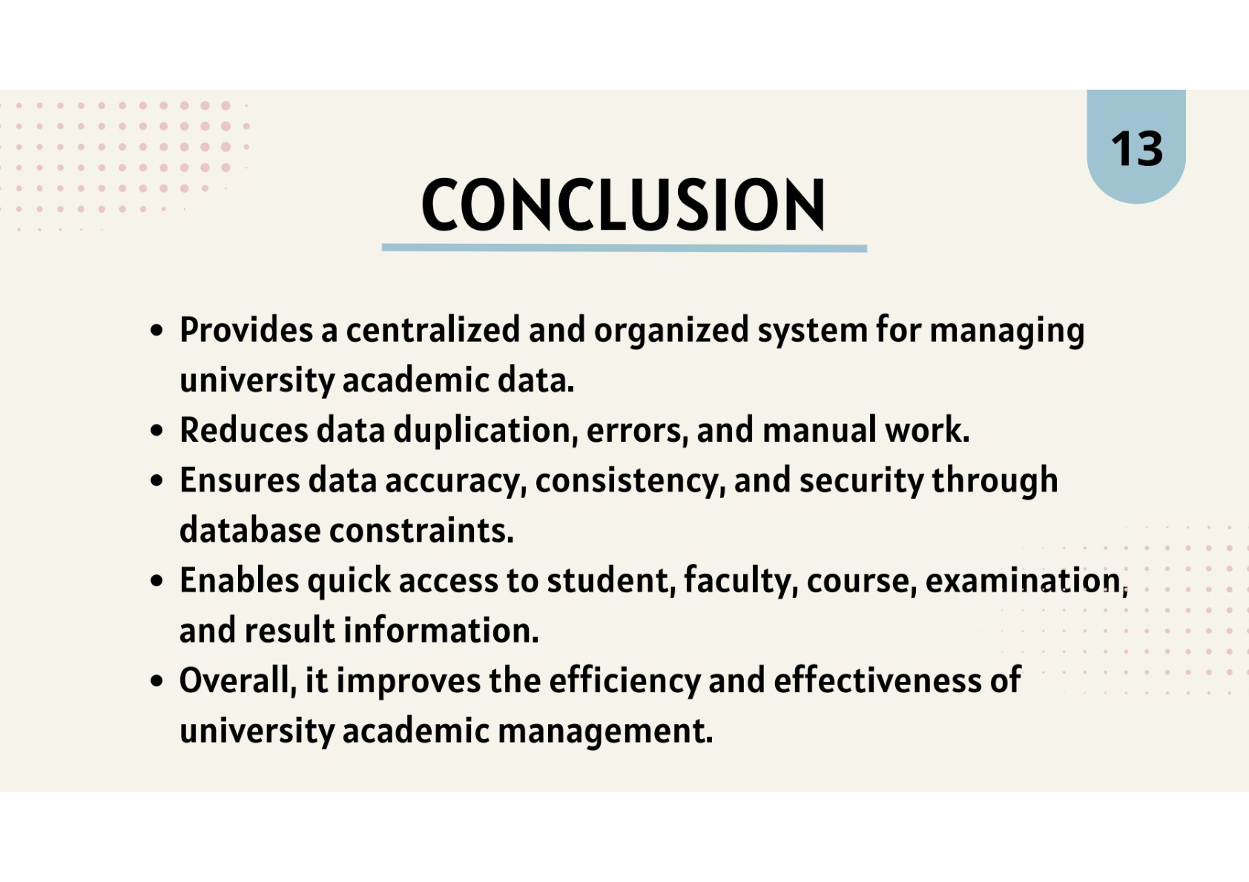

Slide 15


